Slide 1
CSCE 823 In Class Day 02
Perceptrons
Live Synchronous session

Slide 2
Agenda
Key points for Perceptrons
Break
Learning Activity: Perceptrons
After-class coding activity (HW) Introduction

Slide 3
Key points for perceptrons
Biologically inspired model for learning
Can encode multiple types of functions
Training
Limitations

Slide 4
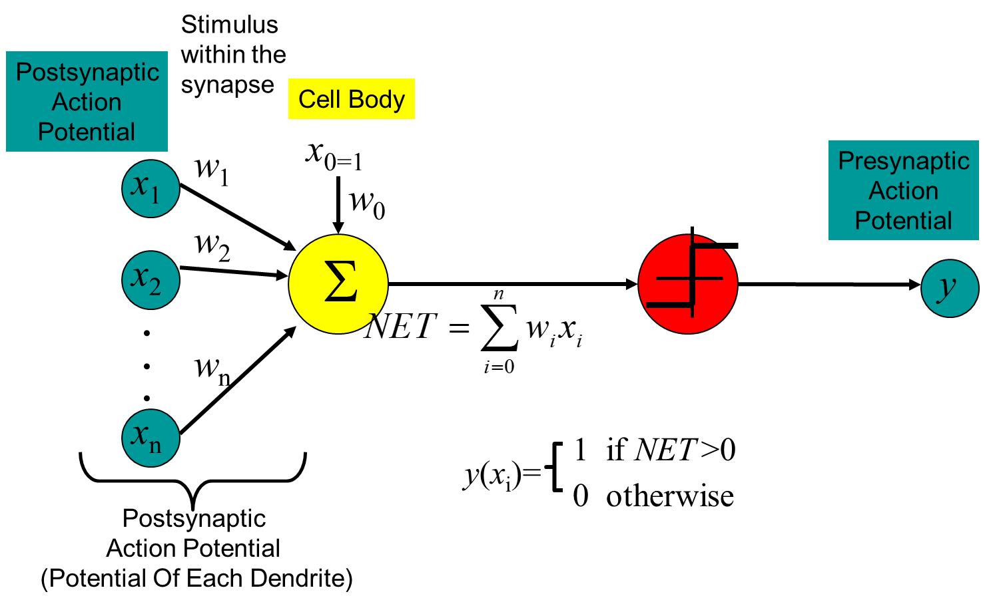
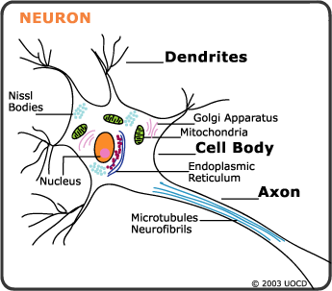
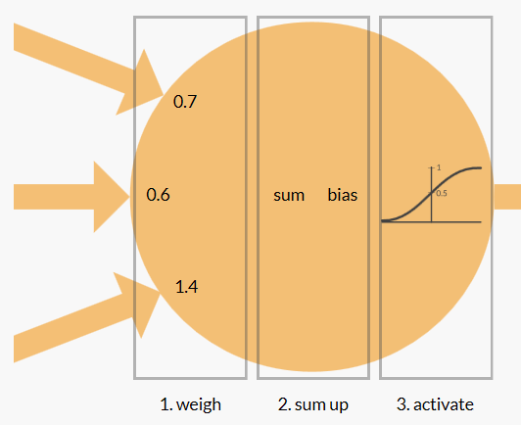
Biological Neurons & Artificial Perceptrons
Connectivity: Neuron outputs are connected to other neurons’ inputs
Activation: Neurons Fire when the cumulative electrochemical stimulation exceeds a threshold
Learning: inter-neural connections have different strengths, and change with use

Slide 5
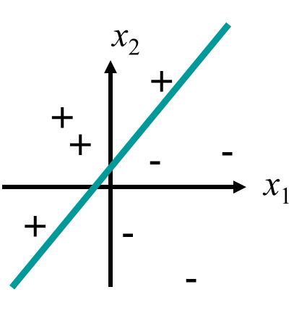
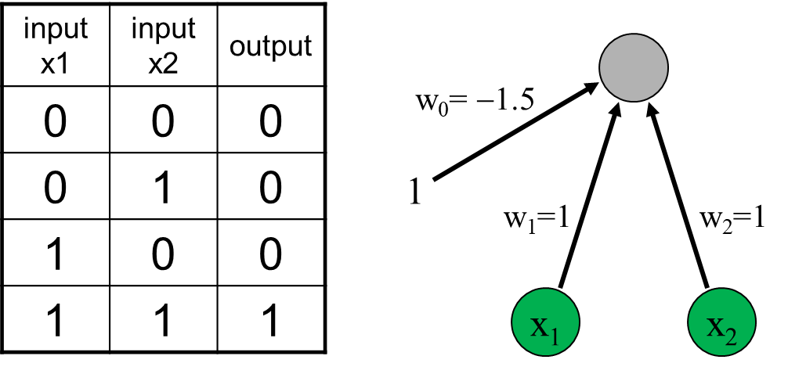

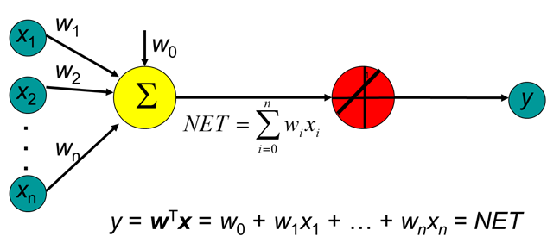
Perceptron Function Encoding
Classification (e.g. Logic AND, Logic OR)
Regression

Slide 6
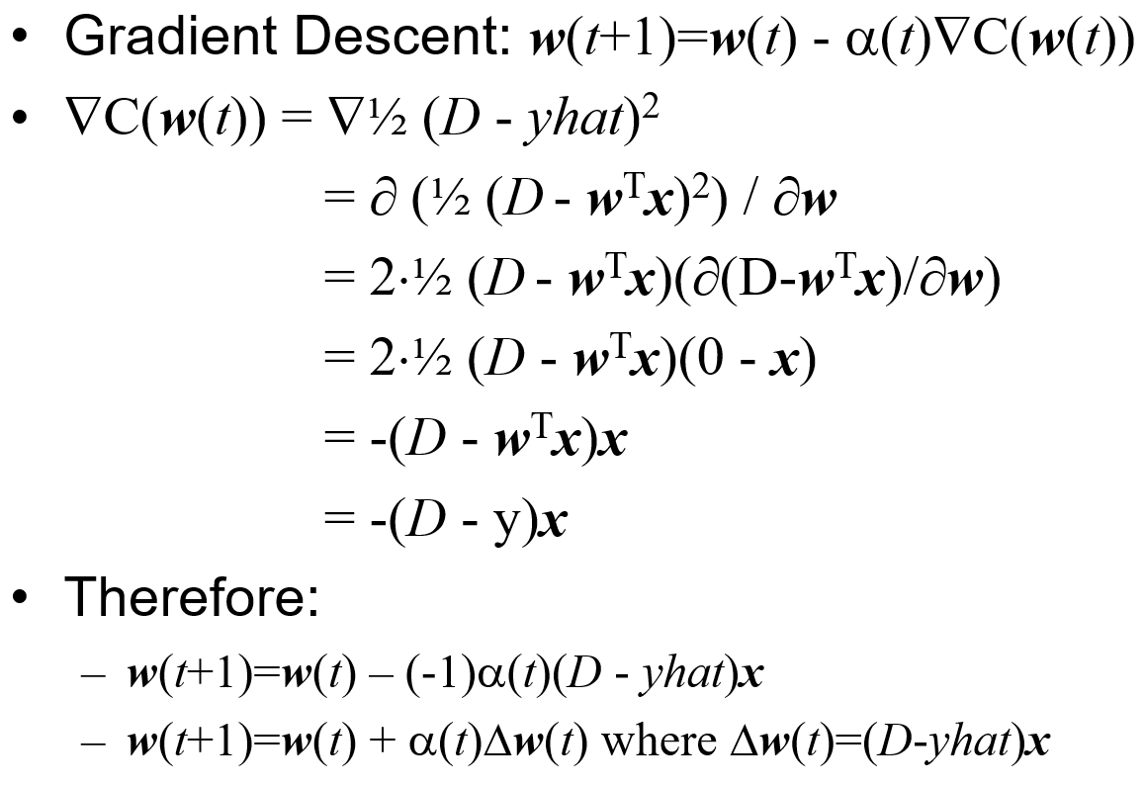
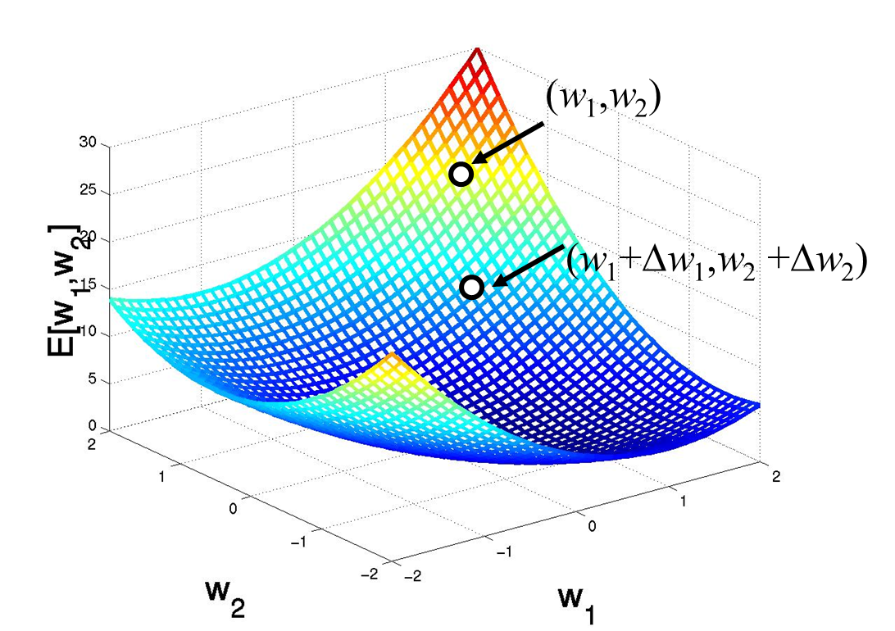
Perceptron Training
Gradient descent-based training
depends on derivative of activation function
Can be trained stochastically by selecting random observation from data for next training update
Online (stream-of-data) training also possible

Slide 7
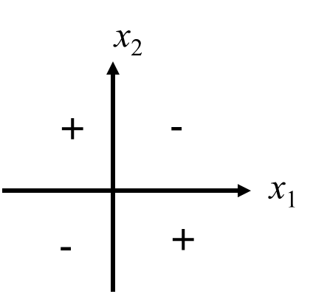


Perceptron Limitations
Cannot create nonlinear separating boundaries
Training can be sensitive to learning rate (too slow; divergence)

Slide 8
Learning Activity- Perceptrons (20 min)
Obtain Student Code From Canvas
Instructor provides Code overview (5 min)
Students complete the coding activity (10 min)
Discussion (5 min)

Slide 9
Break

Slide 10
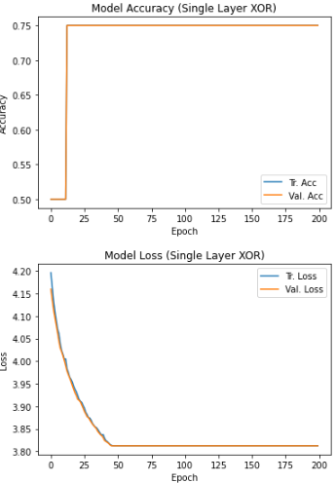
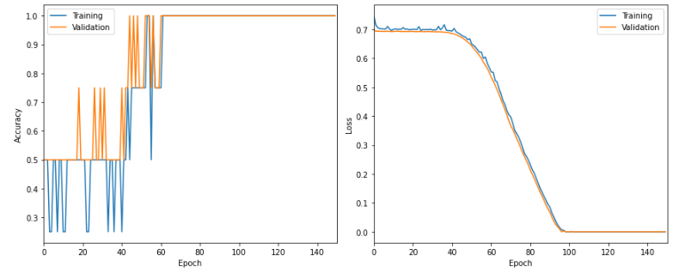
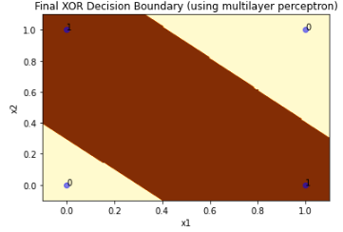
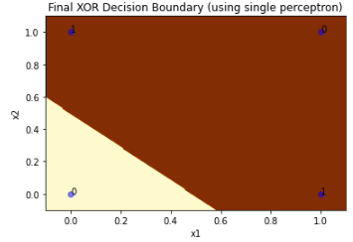
After Class Activity (HW1) Introduction

Slide 11
Q&A

